Slide 2
Absence of Copyright
This slideshow contains photos, diagrams, and information, some of which were attained through internet searches of public websites. The author of this presentation does not own the copyright on this information, so this slideshow is for personal use only—not for sale or profit. Please utilize it to seek the Lord and grow in your knowledge of His Word and ways.
Bro Stan’s Revelation Study is available on our church website:
www.faithprinceton.org

Slide 4
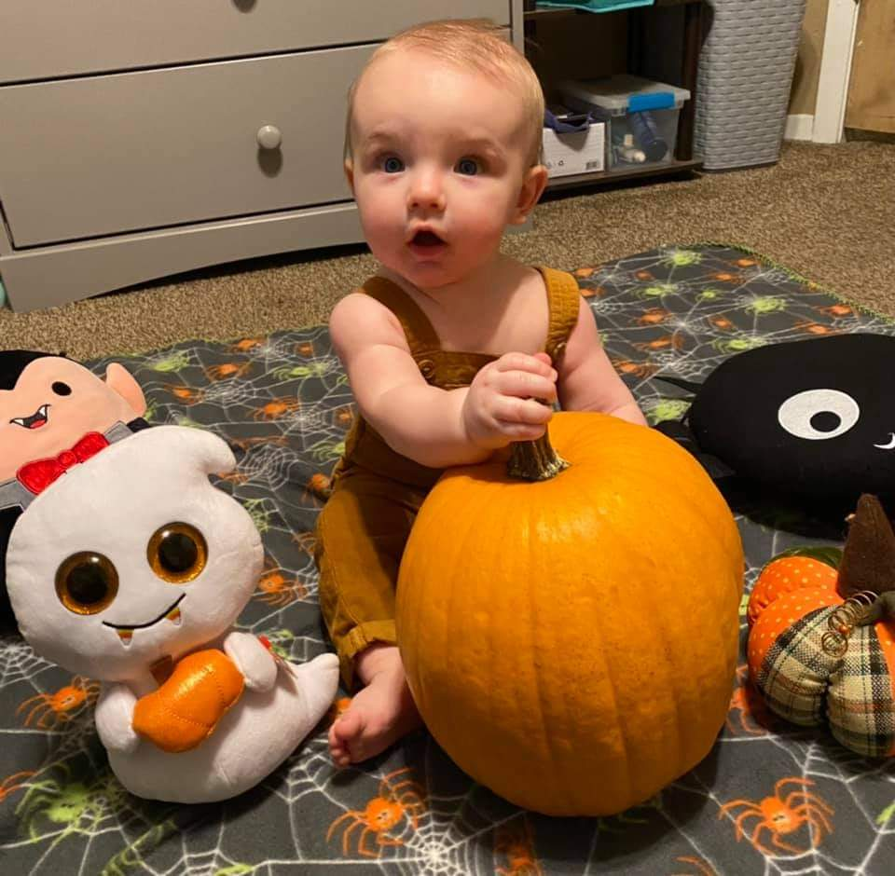
Noah...
Our little pumpkin’

Slide 5
And introducing...

Slide 6
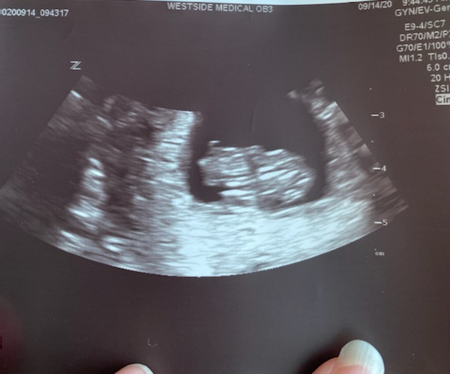
And introducing...
Our newest grand-daughter!
Congratulations Jessie and Pete!

Slide 7
Prayer and Announcements
Sunday:
9:15 Small Group Sunday School Classes
(Kids class and nursery as well)
10:30 Worship

Slide 9
BEGIN HERE OCTOBER 15, 2020
LAST WEEK 21 Revelation 14
The Lamb and 144,000
THIS WEEK 22 Revelation 14 b
Time for Reaping

Slide 10
Revelation 14
V 1-5 The Lamb and 144,000
V 6-13 Three Angels
V 14-20 Two Reapings
V 14-16 The Hour to Reap Souls
V 17-20 The Grapes of Wrath
Notes:
After the dismal outlook of chapter 13 with the rise of the AntiChrist and False Prophet,
We are reminded in chapter 14 about the ultimate victor standing on Mount Zion and orchestrating the end...
QUICK RE-CAP: READ VERSES 1-13 AS REMINDER!!!
V 1-2 The Lamb and 144,000
V 3 A New Song
V 4-5 First fruits to God
V 6-13 three Angels
V 6-7 1st Angel with eternal gospel to preach
V 8 2nd angel announces fall of Babylon
V 9-13 3rd Angel cup of wine of wrath of God
V 11-12 Torment or perseverance
V 13 Rest from labors
V 14-20 two reapings
V 14-16 The Hour to Reap
V 17-20 The Grapes of Wrath

Slide 11
Revelation 14:1-2 The Lamb and 144,000
1 Then I looked, and behold, the Lamb was standing on Mount Zion, and with Him one hundred and forty-four thousand, having His name and the name of His Father written on their foreheads. 2 And I heard a voice from heaven, like the sound of many waters and like the sound of loud thunder, and the voice which I heard was like the sound of harpists playing on their harps.

Slide 12
Revelation 14:3 A New Song
3 And they *sang a new song before the throne and before the four living creatures and the elders; and no one could learn the song except the one hundred and forty-four thousand who had been purchased from the earth.

Slide 13
Revelation 14:4-5 First fruits to God
4 These are the ones who have not been defiled with women, for they have kept themselves chaste. These are the ones who follow the Lamb wherever He goes. These have been purchased from among men as first fruits to God and to the Lamb. 5 And no lie was found in their mouth; they are blameless.

Slide 14
Revelation 14:6-7 An Eternal Gospel to Preach
FIRST ANGEL:
6 And I saw another angel flying in midheaven, having an eternal gospel to preach to those who live on the earth, and to every nation and tribe and tongue and people; 7 and he said with a loud voice, “Fear God, and give Him glory, because the hour of His judgment has come; worship Him who made the heaven and the earth and sea and springs of waters.”

Slide 15
Revelation 14:8 Fall of Babylon
SECOND ANGEL:
8 And another angel, a second one, followed, saying, “Fallen, fallen is Babylon the great, she who has made all the nations drink of the wine of the passion of her immorality.”

Slide 16
Revelation 14:9-10 Wrath of God
THIRD ANGEL:
9 Then another angel, a third one, followed them, saying with a loud voice, “If anyone worships the beast and his image, and receives a mark on his forehead or on his hand, 10 he also will drink of the, wine of the wrath of God which is mixed in full strength in the cup of His anger; and he will be tormented with fire and brimstone in the presence of the holy angels and in the presence of the Lamb.

Slide 17
Revelation 14:11-12 Torment or Perseverance
11 And the smoke of their torment goes up forever and ever; they have no rest day and night, those who worship the beast and his image, and whoever receives the mark of his name.” 12 Here is the perseverance of the saints who keep the commandments of God and their faith in Jesus.

Slide 18
Revelation 14:13 Rest from Labors
13 And I heard a voice from heaven, saying, “Write,
‘Blessed are the dead who die in the Lord from now on!’”
“Yes,” says the Spirit, “so that they may rest from their labors, for their deeds follow with them.”

Slide 19
Two Reapings – Revelation 14:14-20
Notes:
WHERE WE LEFT OFF TWO WEEKS AGO!!! PICKING IT UP FROM HERE!!!
One for the saved ?
One for wrath
Some believe they are both of the same reaping of all people
The wheat and the tares ... Matthew 13

Slide 20
Revelation 14:14-16 The Hour to Reap Souls
14 Then I looked, and behold, a white cloud, and sitting on the cloud was one like a son of man, having a golden crown on His head and a sharp sickle in His hand. 15 And another angel came out of the temple, crying out with a loud voice to Him who sat on the cloud, “Put in your sickle and reap, for the hour to reap has come, because the harvest of the earth is ripe.” 16 Then He who sat on the cloud swung His sickle over the earth, and the earth was reaped.
Notes:
a white cloud, and sitting on the cloud was one like a son of man,
having a golden crown on His head and
a sharp sickle in His hand.
15 And another angel came out of the temple, crying out with a loud voice to Him who sat on the cloud, “Put in your sickle and reap,
for the hour to reap has come, = Jesus said “no one knows the hour...”
because the harvest of the earth is ripe.”
= 2 Peter 3:8-10 ⁸ But do not forget this one thing, dear friends: With the Lord a day is like a thousand years, and a thousand years are like a day. ⁹ The Lord is not slow in keeping his promise, as some understand slowness. Instead he is patient with you, not wanting anyone to perish, but everyone to come to repentance.
¹⁰ But the day of the Lord will come like a thief. The heavens will disappear with a roar; the elements will be destroyed by fire, and the earth and everything done in it will be laid bare.
16 Then He who sat on the cloud swung His sickle over the earth, and the earth was reaped.

Slide 21
Revelation 14:17-20 The Grapes of Wrath...
17 And another angel came out of the temple which is in heaven, and he also had a sharp sickle. 18 Then another angel, the one who has power over fire, came out from the altar; and he called with a loud voice to him who had the sharp sickle, saying, “Put in your sharp sickle and gather the clusters from the vine of the earth, because her grapes are ripe.”
Notes:
the one who has power over fire
New Living Translation Then another angel, who had power to destroy with fire, came from the altar. He shouted to the angel with the sharp sickle, “Swing your sickle now to gather the clusters of grapes from the vines of the earth, for they are ripe for judgment.”
because her grapes are ripe

Slide 22
Revelation 14:17-20 cont The Grapes of Wrath
19 So the angel swung his sickle to the earth and gathered the clusters from the vine of the earth, and threw them into the great wine press of the wrath of God. 20 And the wine press was trodden outside the city, and blood came out from the wine press, up to the horses’ bridles, for a distance of two hundred miles.
Notes:
Winepress of God’s wrath = see Isaiah 63:3 and joel 3:13
Blood for 200 miles = length of Palestine? 163 miles
1600 furlongs = 40 times 40
Lake of blood area?
River of blood length?

Slide 23
Isaiah 63:1-6 Trampled them in Wrath
3 “I have trodden the wine trough alone, And from the peoples there was no man with Me. I also trod them in My anger And trampled them in My wrath; And their lifeblood is sprinkled on My garments, And I stained all My raiment. 4 “For the day of vengeance was in My heart, And My year of redemption has come. 5 “I looked, and there was no one to help, And I was astonished and there was no one to uphold; So My own arm brought salvation to Me, And My wrath upheld Me. 6 “I trod down the peoples in My anger And made them drunk in My wrath, And I poured out their lifeblood on the earth.”
Notes:
Isaiah 63:1-6
1 Who is this who comes from Edom, With garments of glowing colors from Bozrah, This One who is majestic in His apparel, Marching in the greatness of His strength? “It is I who speak in righteousness, mighty to save.” ² Why is Your apparel red, And Your garments like the one who treads in the wine press? ³ “I have trodden the wine trough alone, And from the peoples there was no man with Me. I also trod them in My anger And trampled them in My wrath; And their lifeblood is sprinkled on My garments, And I stained all My raiment. ⁴ “For the day of vengeance was in My heart, And My year of redemption has come. ⁵ “I looked, and there was no one to help, And I was astonished and there was no one to uphold; So My own arm brought salvation to Me, And My wrath upheld Me. ⁶ “I trod down the peoples in My anger And made them drunk in My wrath, And I poured out their lifeblood on the earth.”

Slide 24
Joel 3:12-17 The Harvest is Ripe
¹² Let the nations be aroused And come up to the valley of Jehoshaphat, For there I will sit to judge All the surrounding nations. ¹³ Put in the sickle, for the harvest is ripe. Come, tread, for the wine press is full; The vats overflow, for their wickedness is great. ¹⁴ Multitudes, multitudes in the valley of decision! For the day of the Lord is near in the valley of decision. ¹⁵ The sun and moon grow dark And the stars lose their brightness. ¹⁶ The Lord roars from Zion And utters His voice from Jerusalem, And the heavens and the earth tremble. But the Lord is a refuge for His people And a stronghold to the sons of Israel.
Notes:
JOEL 3:
¹² Let the nations be aroused And come up to the valley of Jehoshaphat, For there I will sit to judge All the surrounding nations. ¹³ Put in the sickle, for the harvest is ripe. Come, tread, for the wine press is full; The vats overflow, for their wickedness is great. ¹⁴ Multitudes, multitudes in the valley of decision! For the day of the Lord is near in the valley of decision. ¹⁵ The sun and moon grow dark And the stars lose their brightness. ¹⁶ The Lord roars from Zion And utters His voice from Jerusalem, And the heavens and the earth tremble. But the Lord is a refuge for His people And a stronghold to the sons of Israel. ¹⁷ Then you will know that I am the Lord your God, Dwelling in Zion, My holy mountain. So Jerusalem will be holy, And strangers will pass through it no more.
God then promises to restore them and bless them... AND AVENGE the blood that He has not avenged yet!!!

Slide 25
Matthew 13 The Wheat and the Tares
37 And He said, “The one who sows the good seed is the Son of Man, 38 and the field is the world; and as for the good seed, these are the sons of the kingdom; and the tares are the sons of the evil one; 39 and the enemy who sowed them is the devil, and the harvest is the end of the age; and the reapers are angels. 40 So just as the tares are gathered up and burned with fire, so shall it be at the end of the age. 41 The Son of Man will send forth His angels, and they will gather out of His kingdom all stumbling blocks, and those who commit lawlessness, 42 and will throw them into the furnace of fire; in that place there will be weeping and gnashing of teeth. 43 Then the righteous will shine forth as the sun in the kingdom of their Father. He who has ears, let him hear.
Notes:
Matthew 13:36-43 The wheat and the tares:
36 Then He left the crowds and went into the house. And His disciples came to Him and said, “Explain to us the parable of the tares of the field.”
37 And He said, “The one who sows the good seed is the Son of Man, 38 and the field is the world; and as for the good seed, these are the sons of the kingdom; and the tares are the sons of the evil one; 39 and the enemy who sowed them is the devil, and the harvest is the end of the age; and the reapers are angels. 40 So just as the tares are gathered up and burned with fire, so shall it be at the end of the age. 41 The Son of Man will send forth His angels, and they will gather out of His kingdom all stumbling blocks, and those who commit lawlessness, 42 and will throw them into the furnace of fire; in that place there will be weeping and gnashing of teeth. 43 Then the righteous will shine forth as the sun in the kingdom of their Father. He who has ears, let him hear.

Slide 26
Revelation 14 Message for Us...
Dr. Rainey’s Rule of Greek:
“Don’t let what you don’t know rob you of what you do know.”
Notes:
We may not know exactly who the 144,000 are, or who sits on the cloud with a sickle, or how blood can flow 200 miles at a depth of 4 to 6 feet, BUT.... We do Know some things we can learn from this chapter....
V 4 Keep yourself pure
Follow the Lamb wherever He goes
You’ve been purchased as first fruits
V 5 Be blameless – no deceit
V 6 Preach the eternal Gospel
v 7 Fear God and Give Him Glory
V 12 Persevere by Keeping the Commandments of God and Faith in Jesus
V 13 Death will bring the blessing of rest
V 14-20 BE READY FOR THE REAPING

Slide 27
Revelation 14 Message for Us...
Keep yourself pure and blameless
Follow the Lamb wherever He goes
Preach the eternal Gospel
Fear God and Give Him Glory... Worship the Creator
Persevere by Keeping the Commandments of God and your Faith in Jesus
Realize that Death will bring the blessing of rest
Be ready for the Reaping
Notes:
V 4-5 purity, obedience, blamelessness
V 4 Keep yourself pure
Follow the Lamb wherever He goes
You’ve been purchased as first fruits
V 5 Be blameless – no deceit
V 6 Preach the eternal Gospel
v 7 Fear God and Give Him Glory
V 12 Persevere by Keeping the Commandments of God and Faith in Jesus
V 13 Death will bring the blessing of rest
V 14-20 BE READY FOR THE REAPING

Slide 28
END HERE OCTOBER 21, 2020
THIS WEEK 22 Revelation 14 b
Time for Reaping

